Slide 1






Ford: Stay Alert !!
Predict
Alertness of a driver (1 or 0)
Accident Probability. (1-100)
Explained by
Environment Variables
Vehicular Variables
Physiological Variables
Challenges:
No data dictionary or column names
Company's strategy for data confidentiality.
To avoid bias in building a model.
No defined data types
Non uniform modelling techniques, approach and evaluation metrics.
Outlier removal or not ?

Slide 2
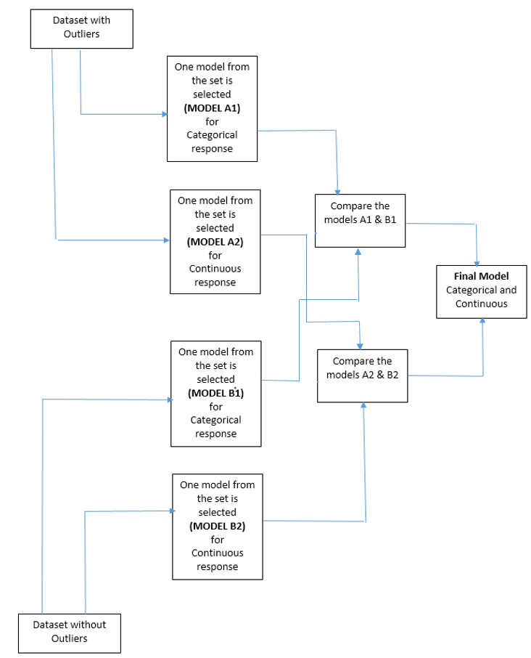
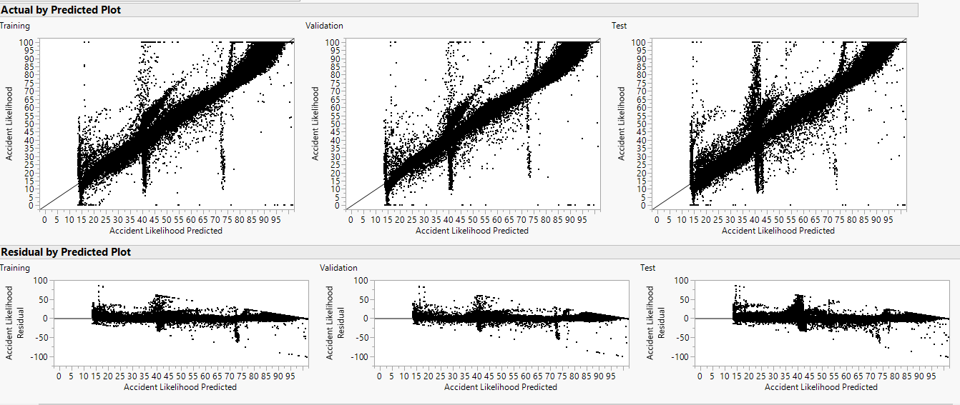
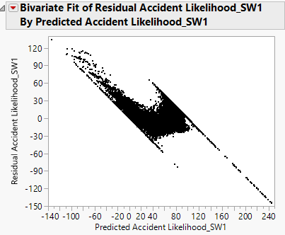
Learnings
Modelling Process
Continuous (Net Revenue) | Categorical (Net Revenue)
Threshold (+/- 5) | Accuracy
Max/Min | Area under the Curve
In Range | Sensitivity Parameters
RMSE (Quantifiable by business ?) | Specificity Parameters
Residual Plots (Visible Trends ?) | TP, FP TN, FN
R-Squared
AIC/BIC
Neural Networks
Singularity
Model evaluation techniques.
R-squared is over-rated.
Residual plots should never be ignored.
Weighted model evaluation ?
Explored
Boosted tree in partition
Generalized linear model
Need for constraint modelling approach.
Transformations, translation or capping of predictions ?
Staying organized helps. (Grouping Columns)
Patience.
Nominal Logistic Regression @ 0.3 cut-off
VS

